Slide 1
Team Computing – GIT, Functions and Motor Sync
TU857/1 Semester 2 2024
Lecturer: Dr. Cathy Ennis
Email: cathy.ennis@tudublin.ie

Slide 2
Credits
This course is based on material developed by :
Cathy Ennis
Dr. Paul Doyle
Material from other sources is also used (citations included)

Slide 3


Overview
Recap / Feedback
Source Code Management with GIT
Movement

Slide 4
Learning Outcomes
Explain and compare different approaches to robot control
List the difficulties facing the development of hardware-based real-time software systems
Demonstrate the ability to implement software to run on a specific hardware base, for example a robot
Demonstrate an ability to work productively in a team

Slide 5
Lab Feedback
What was easy?
What did you learn?
What was hard?

Slide 6
Speed and Direction (Stop)
#pragma config(StandardModel, "EV3_REMBOT")
task main()
{
setMotorSpeed(leftMotor, 50); //Set the leftMotor (motor1)
// to half power forward (50)
setMotorSpeed(rightMotor,50); //Set the rightMotor (motor6)
// to half power forward (50)
sleep(1500); //Wait for 1.5 seconds before
//continuing on in the program.
}

Slide 7
Speed and Direction (Rotate)
#pragma config(StandardModel, "EV3_REMBOT")
task main()
{
setMotorSpeed(leftMotor, 50); //Set the leftMotor (motor1)
// to half power reverse (50)
setMotorSpeed(rightMotor,-50);//Set the rightMotor (motor6)
// to half power reverse (50)
sleep(1500); //Wait for 1.5 seconds before
//continuing on in the program.
}

Slide 8
Distance/time to Rotate
#pragma config(StandardModel, "EV3_REMBOT")
task main()
{
setMotorSpeed(leftMotor, 50); //Set the leftMotor (motor1)
// to half power reverse (50)
setMotorSpeed(rightMotor,-50);//Set the rightMotor (motor6)
// to half power reverse (50)
sleep(1500); //Wait for 1.5 seconds before
//continuing on in the program.
}

Slide 9
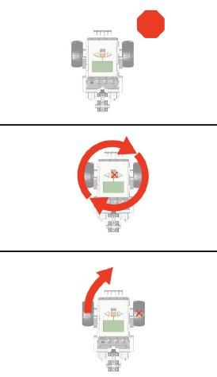
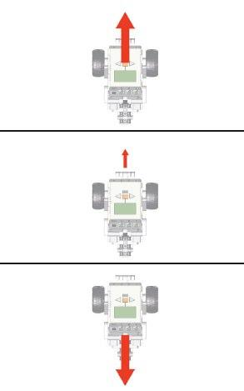
Motor Control

Slide 10
GIT

Slide 11

GIT
Distributed (Decentralized) version control system
Created by same developers as Linux
Version control software: manages changes to a project without overwriting any part of that project
Used for projects big and small
LINIX Kernel for example

Slide 12
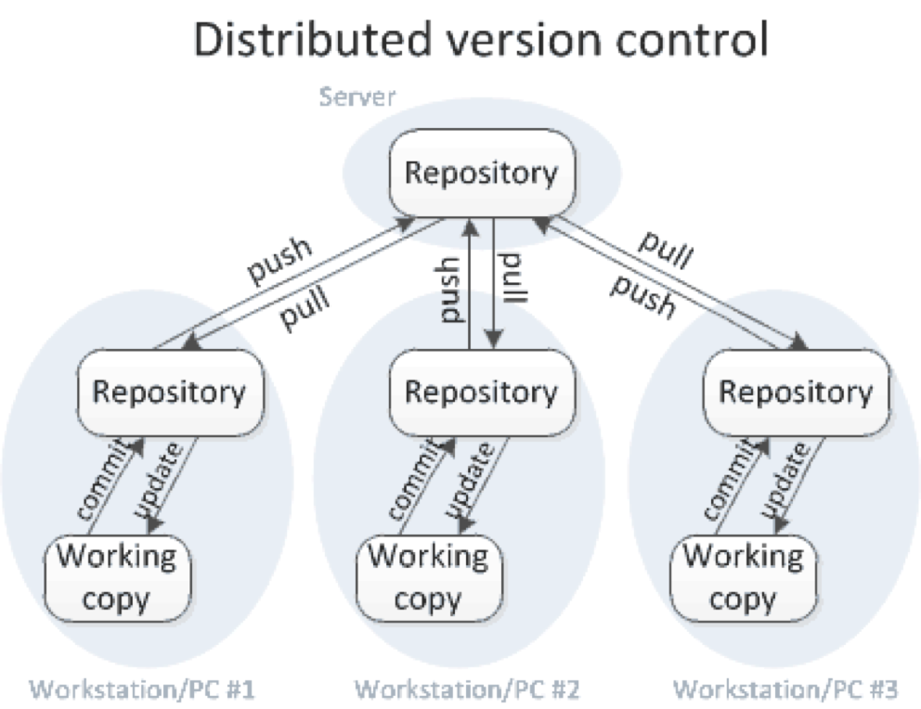
GIT

Slide 13

Who Uses GIT?

Slide 14
Why use GIT?
If you and your teammate are both working on your code for Robotc
You make your changes, save them, and upload them back to the website
What if your teammate is working on the same page as you at the same time? One of you is about to have your work overwritten and erased
What if your LAPTOP or Computer crashes?

Slide 15
GIT Workflow
Git manages changes to a tree of files over time
Git is optimized for:
Distributed development
Large file counts
Complex merges
Making trial branches
Being very fast
Being robust

Slide 16
What can you do?
Clone the repository
Make and test local changes
Submit the changes as patches via mail
OR submit them back to the published repository

Slide 17
GIT Terminology
Command Line: (We will use GIT BASH)
Computer program we use to input Git commands
A non-native program that you download when you download Git for the first time
You type text-based commands, known as prompts

Slide 18
GIT Repository
Repository:
Directory or storage space where your projects can live
Local to a folder on your computer, or it can be a storage space on BitBucket
You can keep code files, text files, image files… inside a repository
GIT
Source Code Control system
GITHUB or Bitbucket
Source Code Repository Site

Slide 19
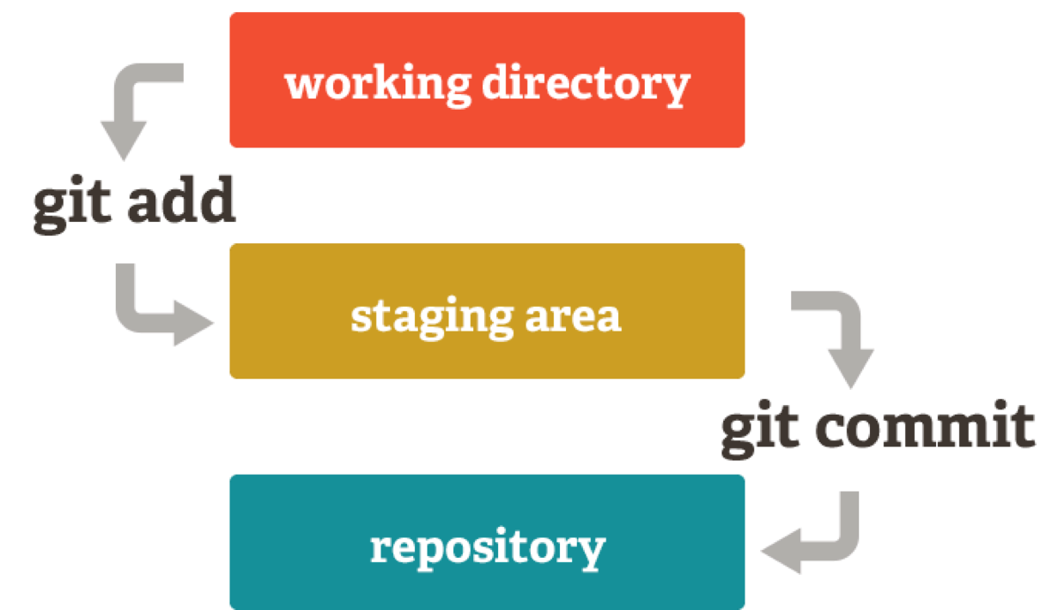
Basic Process On Local Machine

Slide 20
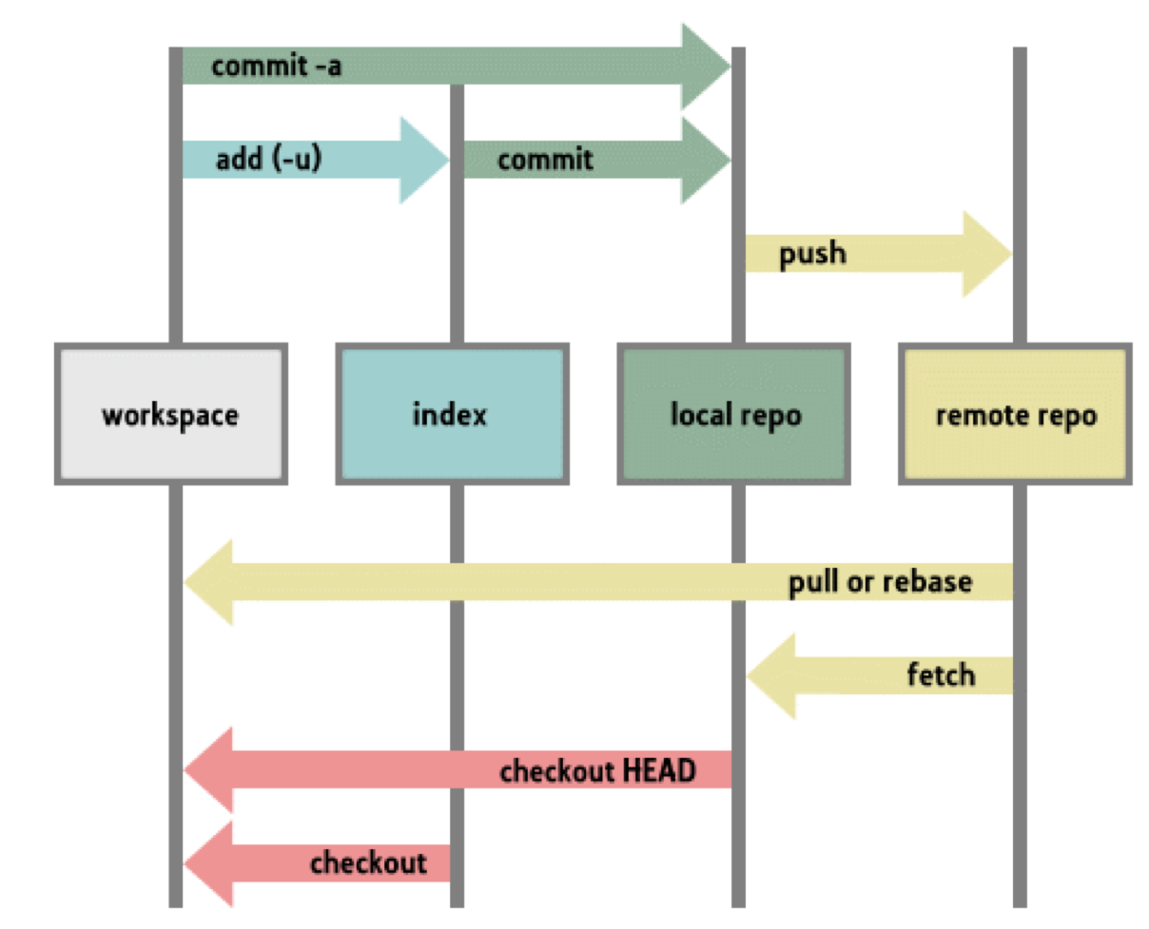
Using a Repository Site

Slide 21
Version Control
The purpose Git was designed to serve
With Git, you don’t have to overwrite or save multiple versions
Keeps “snapshots” of every point in time in the project’s history

Slide 22
GIT Mangement
Set up a repository site
Bitbucket
Create a new repository
teamcomputing
Clone the repository
Add a file to the repository
Push file to repository site

Slide 23
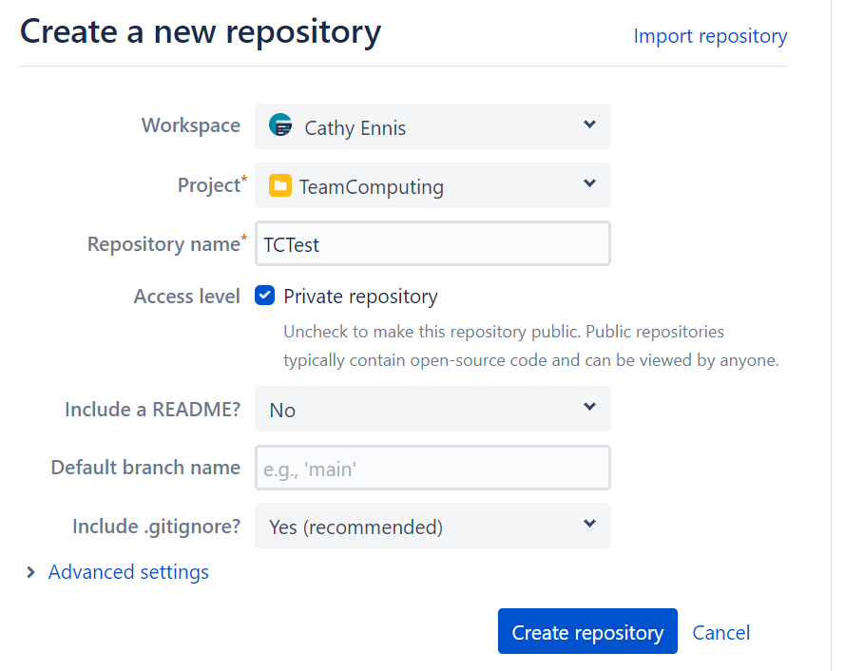
Bitbucket Cloud Repository

Slide 24
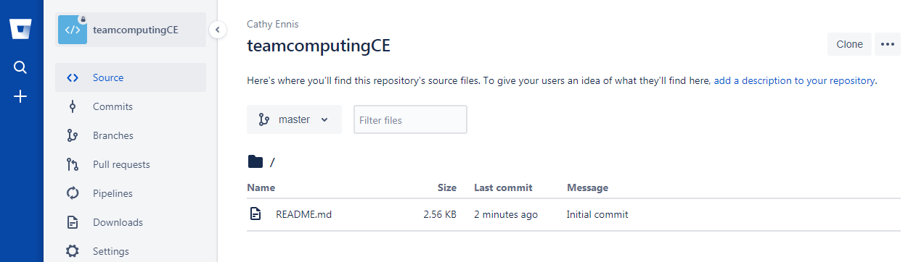
Get the address of the repository

Slide 25
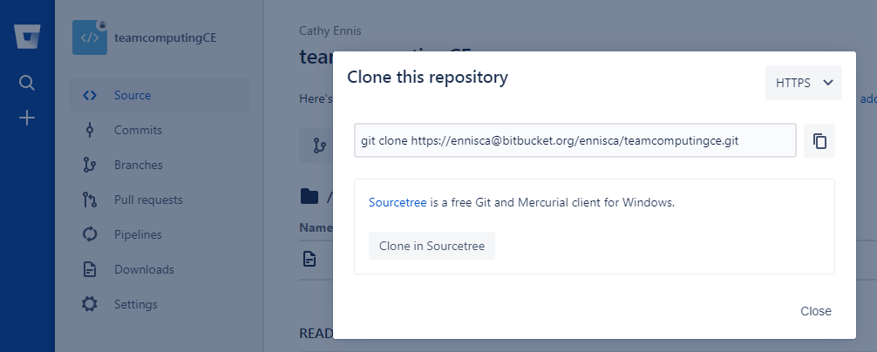
Get the address of the repository

Slide 26
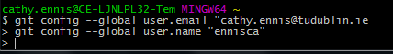
GIT Configuration - GITBash
Use GITBash command line

Slide 27
Clone
Allows you to create a copy of a repository from bitbucket
Your local machine will now have all the files that were on the repository site.

Slide 28
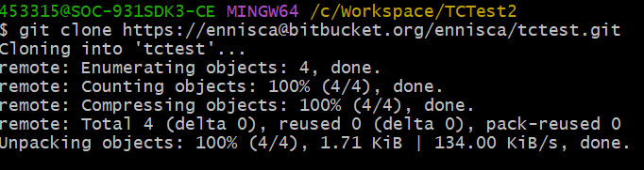
Clone
You will be asked to authenticate your account

Slide 29
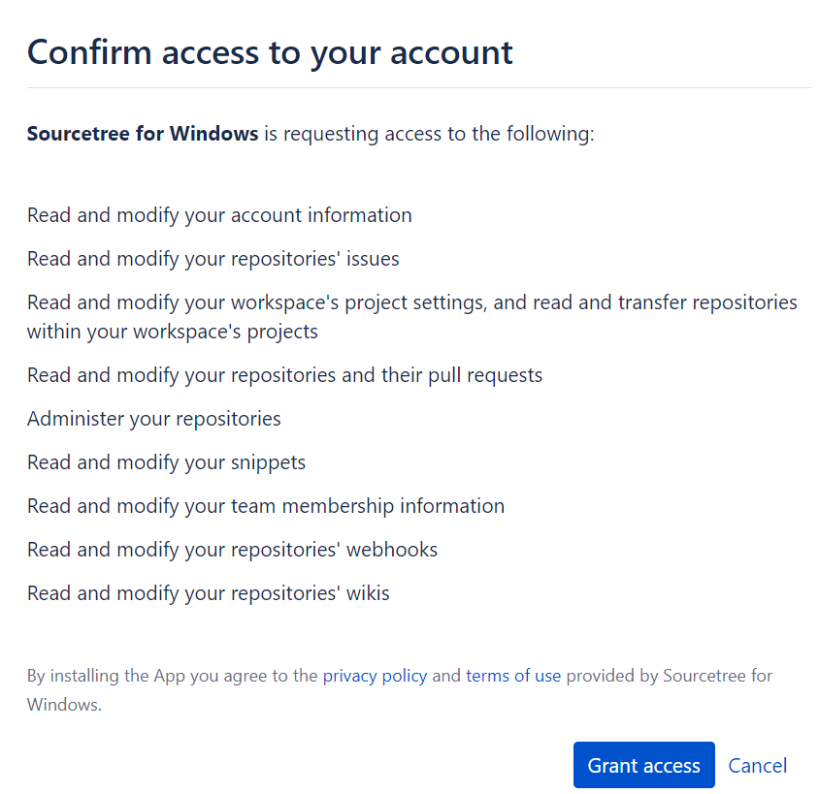
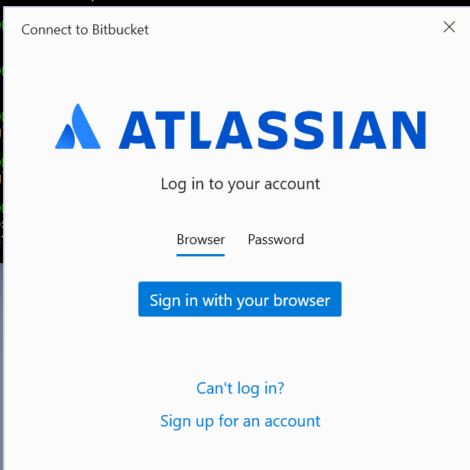
Verify your account

Slide 30
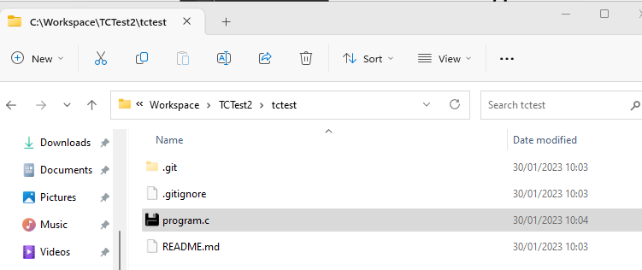
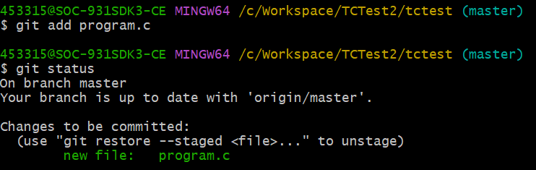
Add
Brings new files to Git’s attention
Notes:
If you navigate to the repo, and create your files there for the lab, you can add them to the repo.

Slide 31
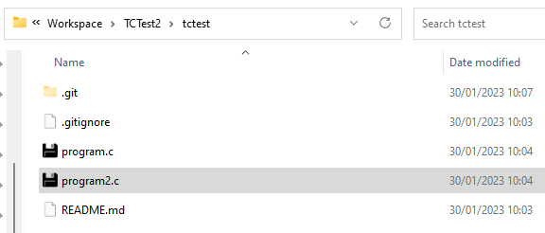
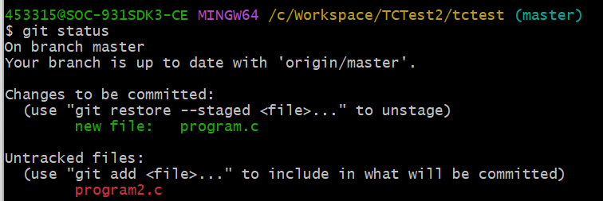
Add
A file must be added for it to be managed by GIT
Notes:
If I add another file but it has not yet been added, it’ll look like this.

Slide 32
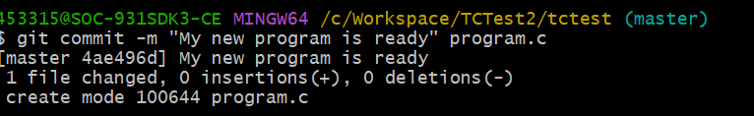
Commit
The command that gives GIT its power
When you commit, you take a “snapshot” of your repository at that point in time, giving you a checkpoint to restore your project

Slide 33
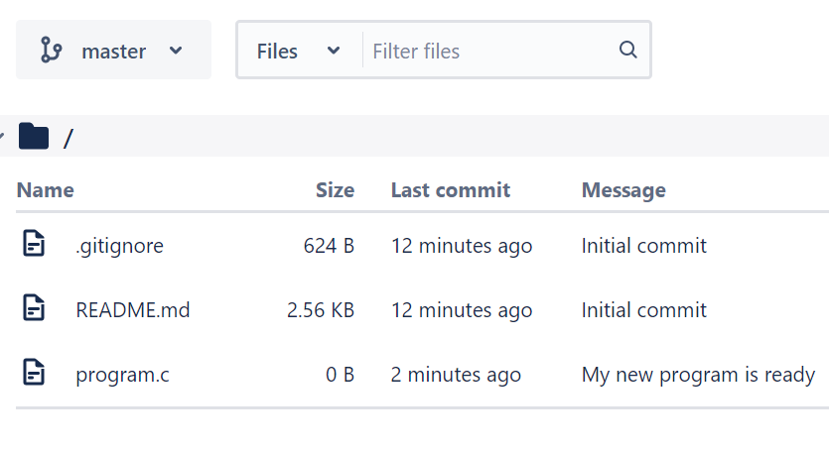
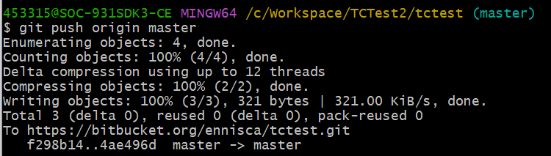
Push
If you’re working on your local computer, and want your commits to be visible online on Repository Site as well, you “push” the changes up to site. You may be asked for a password

Slide 34
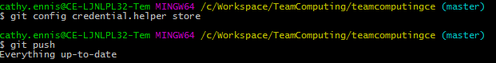
Issues with credentials
You should not have any issues if you use your browser to authenticate your account, but if you do, use the following command:
If you get “invalid credentials” error despite entering login details, you may need to create an app password for gitbash to push your remote repo:
https://www.theserverside.com/blog/Coffee-Talk-Java-News-Stories-and-Opinions/How-to-generate-a-Bitbucket-App-Password-example

Slide 35
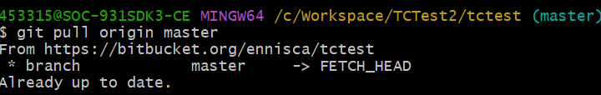
Pull
You can make sure you have the latest copy of the files on the site repository using this command

Slide 36
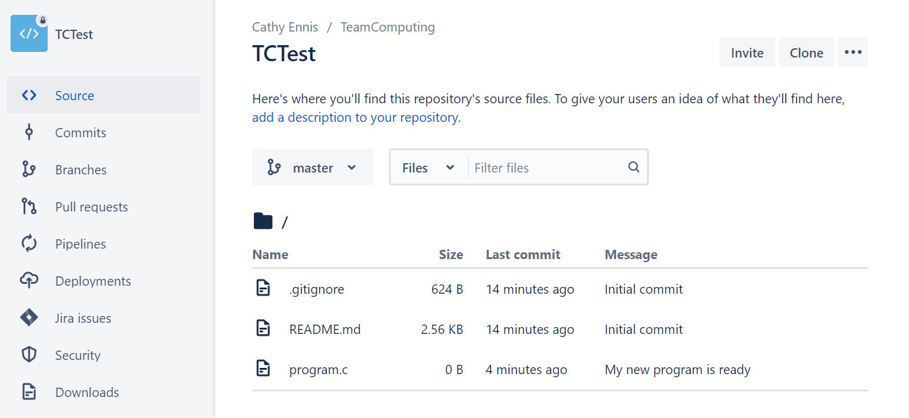
Verify Sources Are Now On The Website

Slide 37
Working Separately Safely
Bitbucket
“Repo”
PUSH
PULL
program1.
program1.

Slide 38
Branch
How multiple people work on a project at the same time
“Branch off” of the main project with your own version full of changes you make yourself
“Merge” that branch back with the “master,” the main directory of the project

Slide 39
GIT commands
git init: Initializes a new Git repository
git config: “configure,” most useful when you’re setting up Git for the first time
git help: brings up the 21 most common git commands.
git status: Check the status of your repository
git add: brings new files to Git’s attention
git commit: after you make any sort of change, you use this to take a “snapshot” of the repository

Slide 40
GIT commands
git branch: lets you build a new branch, or timeline of commits, of changes and file additions that are completely your own
git merge: you can merge your changes back to the master branch
git push: send commited files to the site repository
git pull: if you’re working on your local computer and want the most up-to-date version of your repository to work with, you “pull” the changes down from GitHub

Slide 41
Better Movement

Slide 42
Synchronising Movement
Did you notice last week that your robot didn’t always move straight with equal power values to each motor?
Why is this?
SPEED isn’t set by you, motor POWER is
Different motors can have different powers
How can you fix this?

Slide 43
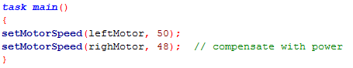
Going Straight
You can do it manually:
Any problems with this?
What if you’re on a differently sloped table? What if you have less battery power?

Slide 44
PID Control
You can also use PID Speed Control Algorithm
Proportional-Integral-Derivative
With rotation sensors, the robot can be aware of how far each wheel has moved
By comparing the motor’s current position to its position a second ago the robot can calculate how fast the wheel is moving

Slide 45
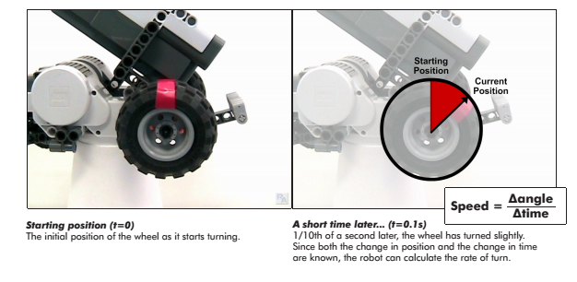
PID

Slide 46
Speed
Speed is translated into a “speed rating”
A speed rating of 100 = an “ideal motor” running at 100% power
The robot can now tell how fast the wheel is actually turning, it can use PID to tune the motor power levels to make sure it is running at the correct speed
If the motor’s actual speed is lower than it should be, the PID algorithm will increase its power level. If the motor is ahead, PID will slow it down

Slide 47
PID & Synchronizing Movement
Desired Speed
50
Motor Power
50
Measured Speed
46

Slide 48
PID & Synchronizing Movement
Desired Speed
50
Motor Power
50
Measured Speed
46
Error
4

Slide 49
PID & Synchronizing Movement
Desired Speed
50
Motor Power
50
Measured Speed
46
PID Adjustment
5
Error
4

Slide 50
PID & Synchronizing Movement
Desired Speed
50
Motor Power
55
Measured Speed
46
Keeps Loops and
keeps adjusting
PID Adjustment
5
Error
4

Slide 51
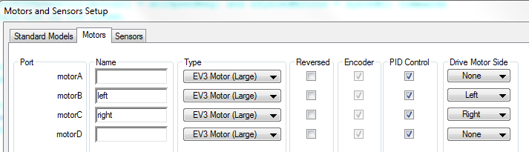
EV3 Motor Setup
Step 1, ensure you are using the PID control by selecting the setting when configuring your motors:

Slide 52
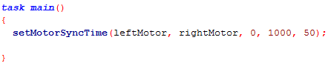
Commands to help sync motors - setMotorSyncTime
Synchronizes two motors for a specified amount of time.

Slide 53
setMotorSyncTime
nMotorOne: The first motor to be synchronized.
nMotorOne: The second motor to be synchronized.
nTurnRatio: Determines what % of nSignedPower is applied to each motor:
100 applies power to nMotorOne and negative power to nMotorTwo.
-100 applies negative power to nMotorOne and power to nMotorTwo.
0 applies equal power to nMotorOne and nMotorTwo (straight movement).
50 applies all of the power to nMotorOne and zero power to nMotorTwo.
-50 applies zero power to nMotorOne and all of the power to nMotorTwo.

Slide 54
setMotorSyncTime
nTimeMsec: Determines how long the motors will move for (in milliseconds).
nSignedPower: Determines the 'maximum' power used by nTurnRatio.
A motor receiving 100% power (determined by nTurnRatio) will move at the speed set by nSignedPower.

Slide 55
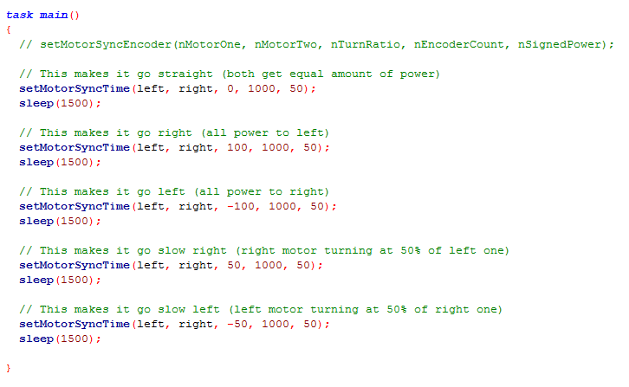
Sample Program

Slide 56
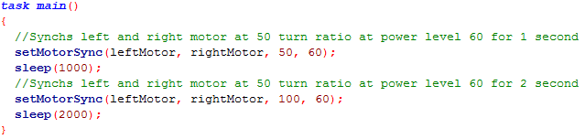
Commands to help sync motors - setMotorSync
Synchronizes two motors (until changed)

Slide 57
Functions

Slide 58
Functions in C
Review your notes on programming functions in C
In RobotC, we can use functions to code repeated behaviours e.g., check for something, perform 90degree turns left/right etc.
Return values
Pass values

Slide 59
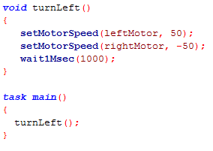
Void Functions

Slide 60
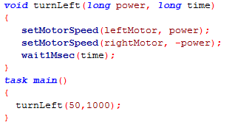
Passing Parameters To Function

Slide 61
LAB Overview
Students work in teams and submit a single GIT REPO for their work covering part A & B of the Lab
Code should be commented and well structured
The quiz/Part A may take longer that the allocated lab time, so students can complete them at home
Lego Robots won’t be available outside of LAB time, so all coding should be completed in the class LAB time
Additional resource links will be provided to help students who are struggling with the material
Reference ROBOTC for EV3 for additional help on commands

Slide 62
Part A
Create your BITBucket account
Create a new teamcomputing repo with LAB2 subdirectory with a README file inside it
Do the Linux Commandline tutorial
Answer questions on GIT
Clone your repo using GITBASH onto your laptop or desktop

Slide 63
Part B
Download the sample c file from Brightspace, run it and insert into your REPO into the following directory: teamcomputing/lab2
Write a new program teamcomputing/lab2/lab2-noPID.c which uses NO PID control and implements the following functions. The program should also test each of the functions:
void turn90degreesLeft()
void turn90degreesRight()
void goForward1second()
void swingRight90degrees()
void swingLeft90degrees()
void reverse1second()

Slide 64
Part B
Write a new program teamcomputing/lab2/lab2-PIDSYNC.c which USES PID control and implements the function below using just the SetMotorSyncTime command:
void moveRobot(long nMotorRatio, long time, long power)
Using only calls to this function write a program that makes the robot
Go in a square and return to original position (random direction)
Go forward for 5 seconds at full speed, then do 180degree spin and at half speed travel back to the original starting position

Slide 65
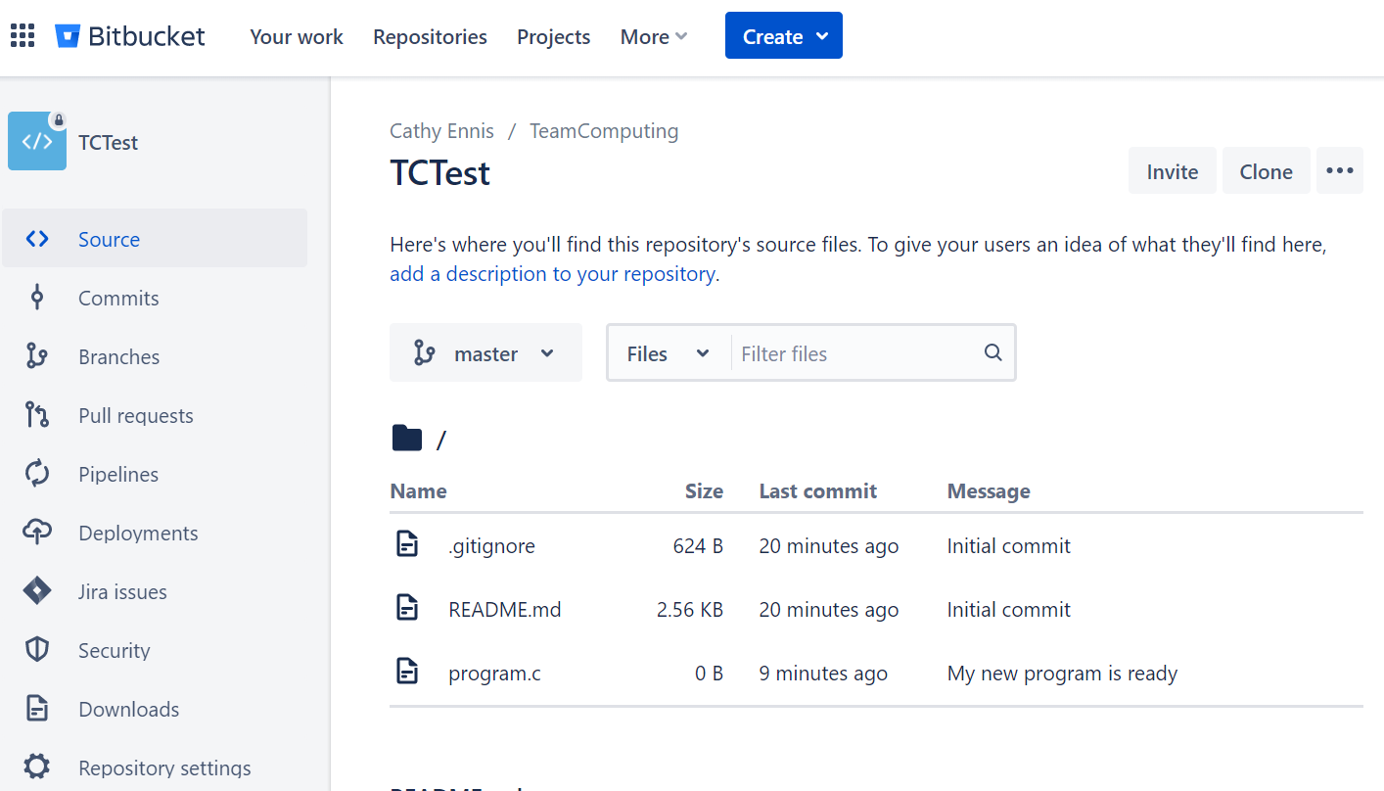
Share Your Repos With Me

Slide 66
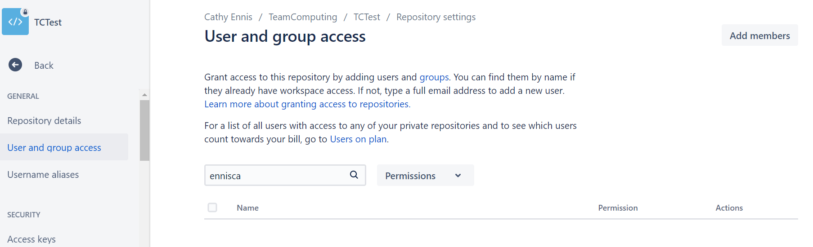
Share Your Repos With Me

Slide 67
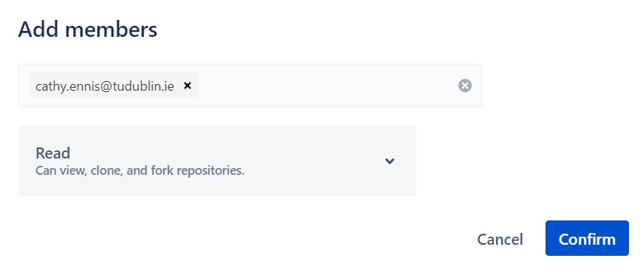
Share Your Repos With Me

